Slide 1
Switch Statements

Slide 2
Switches
Another way to branch, similar to if, else if, …, else
Use when have to compare a single item against a specific values, and run code based on the comparison.

Slide 3
Switch Syntax
switch (variable)
{
case (literal1):
...
break;
case (literal2):
...
break;
...
default:
...
break;
}

Slide 4
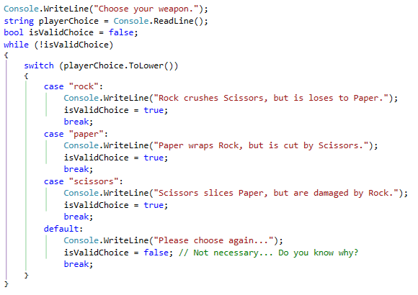
Switch Example

Slide 5
Switch Continued
The variable and the cases have to be comparing the same data type.
Default is a catch-all, like the else in a big if, else if…
The cases have to constants, like string literals, or integers, or enumeration values (more on enums later)
The break works like a break in a while loop… did we cover this?

